Slide 1
A new datatype in LabVIEW
Sets and Maps
Peter Horn – CLA/CTA
Senior Applications Engineer - NI

Slide 2
Thanks to PrimaryKey (Piotr Kruczkowsk)

Slide 3
Agenda
What are LabVIEW Sets and Maps?

Slide 4
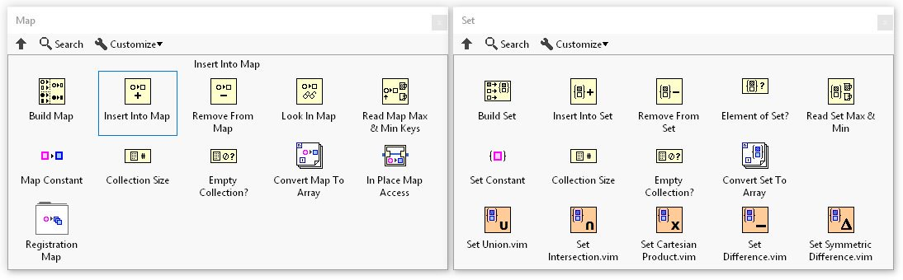
What are LabVIEW Sets and Maps?
Notes:
Its worth noting that some of the vim’s inside the Sets palette also work on Maps.
You may see other names such as Dictionaries, Associative Arrays and Hash Tables. These are all very similar to Maps and can now be programmed in LabVIEW.
In the past LabVIEW users have achieved this functionality through Variant Attributes.

Slide 5
When to use LabVIEW Sets and Maps
When quick look up is important
Where you would previously have built a Variant Attribute Lookup Table
When context matters
Configuration and measurement data
Conditions and actions
Dynamic size clusters
Trees or database type behaviour

Slide 6
Avoid Nested Loops

Slide 7
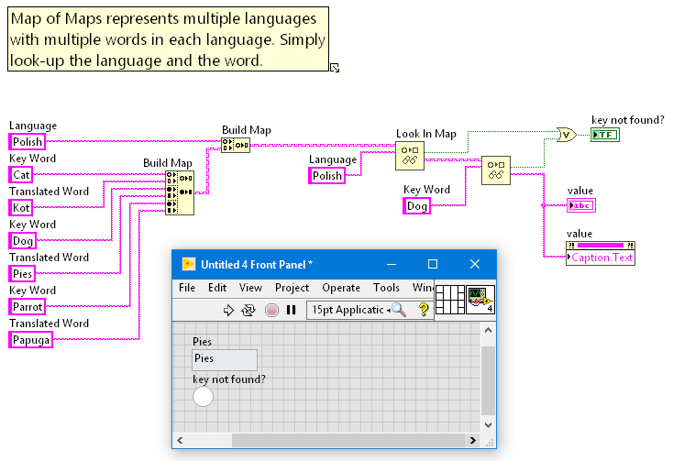
An extension of this could be a translation utility

Slide 8
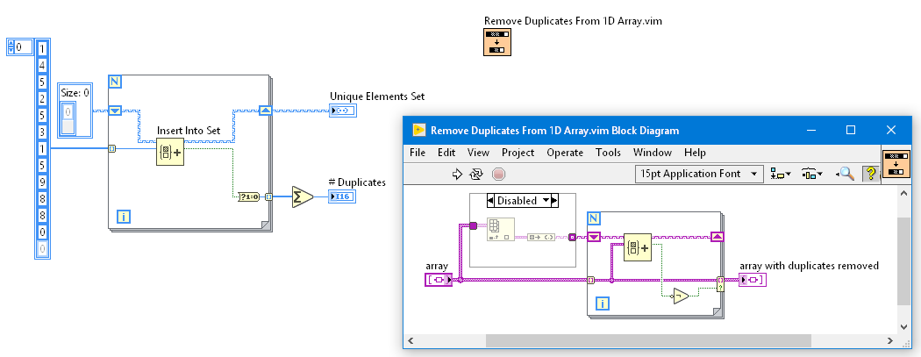
Finding unique elements in an array

Slide 9
Service/Actor Management
Service 2
Service 3
Service 1
Central Service Module
Service 4
Service 6
Service 5
Notes:
I’ve run into situations in the past where I need to keep track of which Service Modules are currently active, and what responsibilities they have. I’ve tried to build things like a variant attribute table, or a JSON config string to keep records of the data, maps can help here too. There is an example in the example finder named Registration Map Usage which shows how to do it.

Slide 10
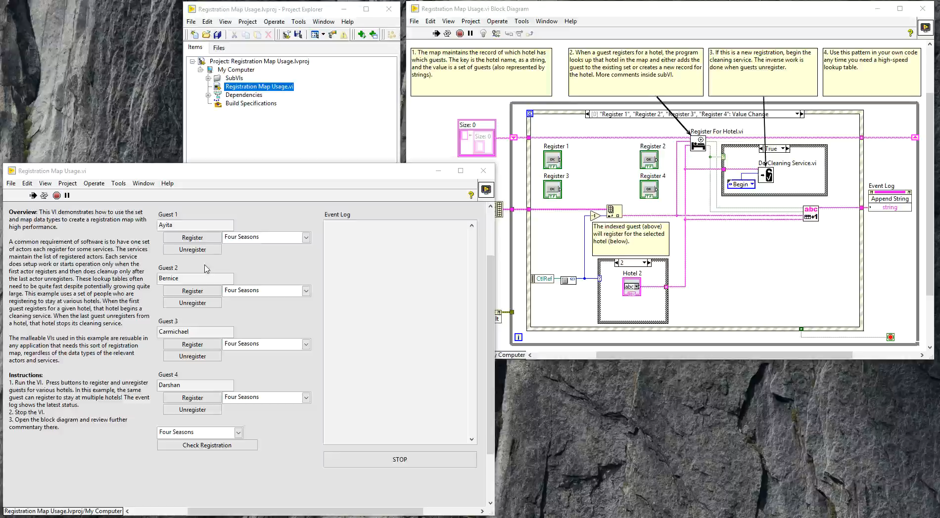
Service/Actor Management

Slide 11
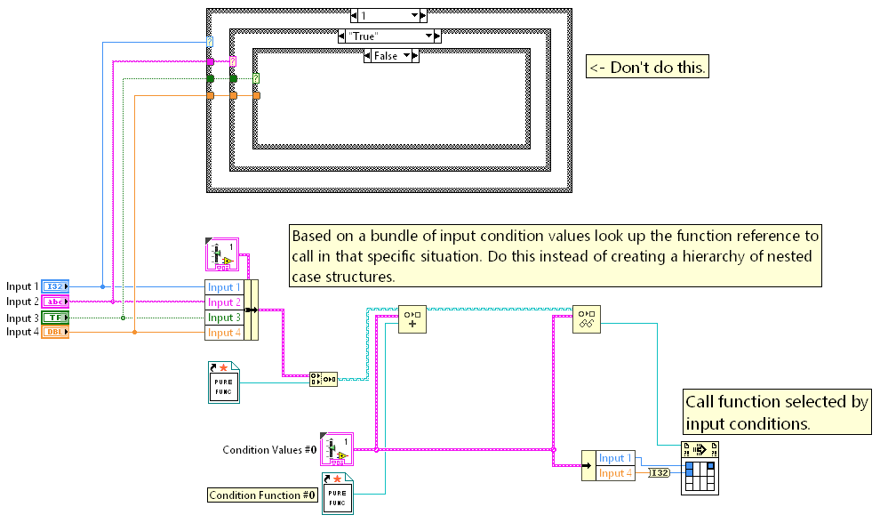
Decision Trees

Slide 12
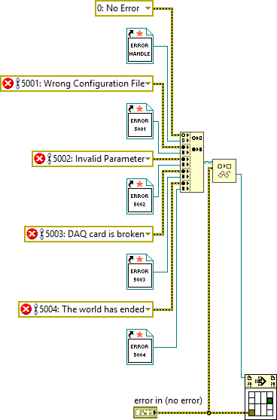
Decision Trees

Slide 13
Performance

Slide 14
Performance

